Slide 1

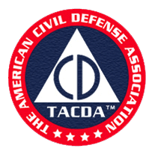
Basic Emergency Care
Putting the Pieces Together
The American Civil Defense Association
Educating American Families About Civil Defense Since 1962!

Slide 2
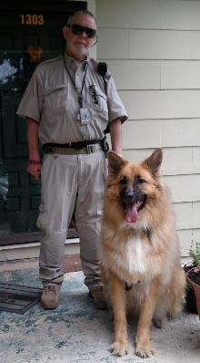
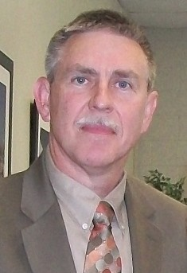
Colonel Jim Smith
More than 50 years experience as a paramedic and public safety responder
Public safety director for a rural community, served as a Captain and Bureau Commander for a metropolitan police agency, and served as public safety coordinator for a large university system
Researched, written, and published more than 50 articles in journals, with two patents in the explosive and blast mitigation arenas derived from this research
Master of science in safety from University of Southern California
Coauthor of Tactical Medicine Essentials textbook endorsed by the American College of Emergency Physicians
Teaches “TacMed Essentials,” the course designed from Tactical Medicine Essentials for physicians, nurses, and EMSP
ACLS, PALS, BLS, and ITLS Instructor since the program's inception in the 1970s and 1980s
Teaches at every level of EMSP classes since 1975
Teaches for two universities, state regional EMS Council, guest instructor at a medical school
Served on federal counter terrorism task force
Deployed with a federal counter terrorism task force, photo with Baby Bear at 140 pounds

Slide 3
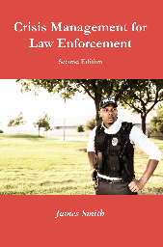
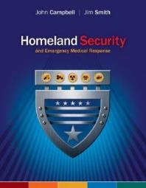
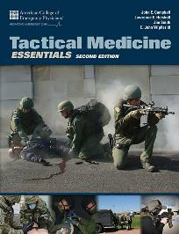

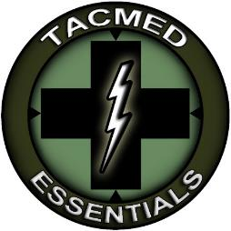

Slide 4
Overview
Bleeding Control
Burns
Chest Pain
Febrile Illness
Nausea, vomiting, diarrhea, and dehydration
Animal bites, reptile bites, Hymenoptera stings, and others
Taking the wrong medication or children ingesting adult medications
When you need to go to the hospital, see a physician, or obtaining EMS assistance

Slide 5
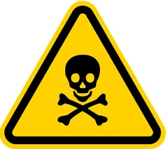
What is the more dangerous?
Statistically what are the more dangerous?
Driving a motor vehicle
Living in a very high crime area
Hospital inpatient or prescribed a new drug
Snakebite
Honeybee Sting
Bear attack
Handling cows as a cowboy
Shark attack
Encounter with a North American Deer

Slide 6
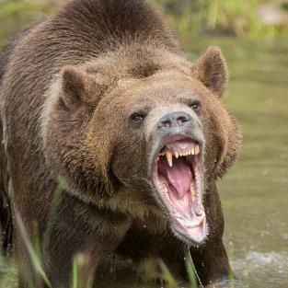
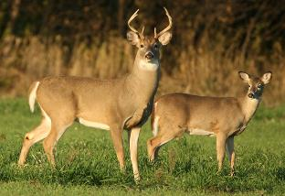

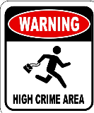
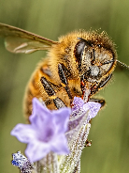

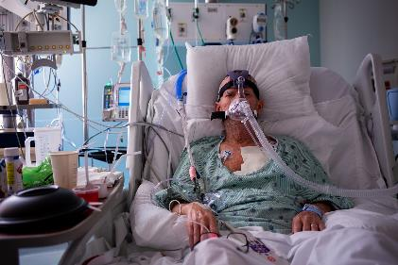
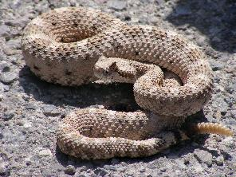
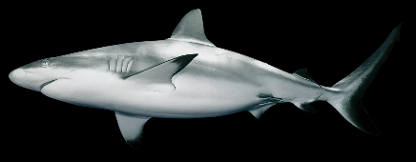
Dangerous?

Slide 7
Data from CDC
Deaths
Driving a motor vehicle Roughly 45,000 deaths
Living in a very high crime area Roughly 16,000 homicides (US DOJ)
Hospital inpatient/prescribed a new drug Roughly 100,000 deaths by medical mistakes/reactions*
Snakebite Less than 20
Honeybee Sting Roughly 1,000 (Allergic reaction)
Bear attack Less than one
Handling cows as a cowboy Roughly 300
Shark attack Less than one
Encounter with a North American Deer Roughly 200 (MVC)
*Some studies suggest this number is closer to 250,000 deaths

Slide 8
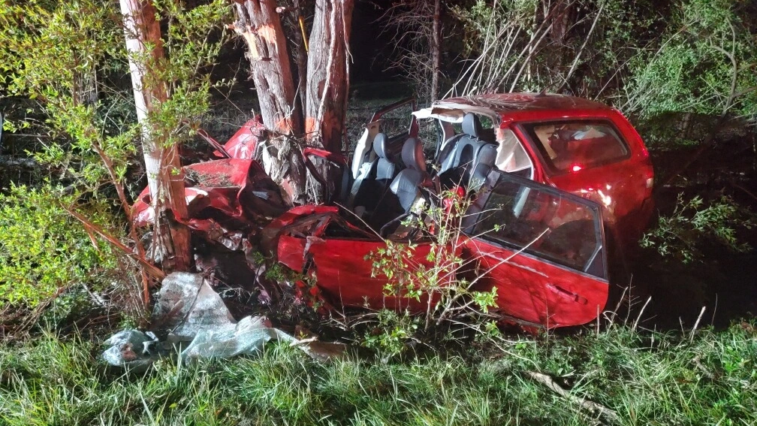
Scene Safety
Make certain the scene is safe enough for you to enter
Motor vehicle crashes can be a dangerous site
  Other vehicles may strike you
  Other vehicles may strike the damaged vehicles
  Spilled fuel or other fluids
  Unstable vehicles

Slide 9
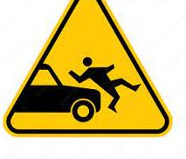
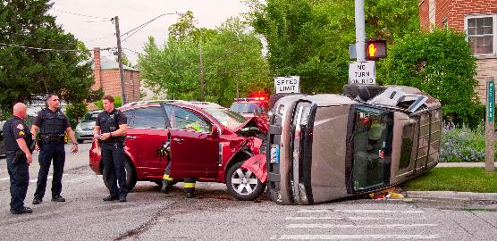
Person entrapped, usually require specialized equipment and trained personnel to remove

Slide 10
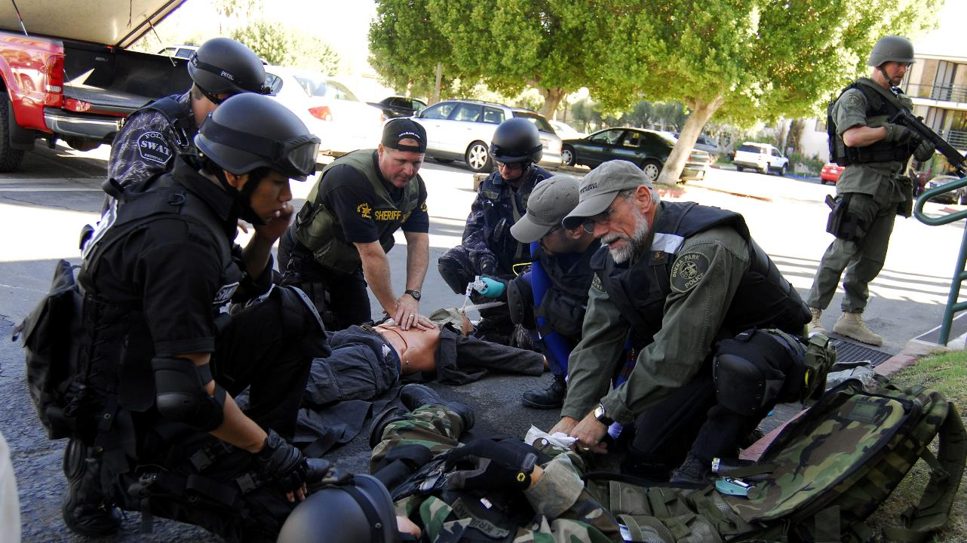
Some areas may be too dangerous!

Slide 11
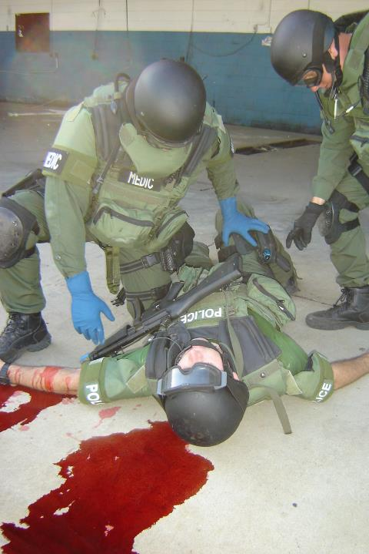
Shock from Blood Loss
Remember, one needs an open airway, a person must be breathing adequately, and have a palpable pulse at the radial artery, femoral artery, or carotid artery
  BP likely 70 mmHg if palpable radial artery
  BP likely 60 mmHg if palpable at the femoral artery
  BP likely less than 90 mmHg if palpable only at the carotid artery
BP less than 100 coupled with a pulse over 100 suggests shock from blood loss!
Call A CAB N Go Hot – Tactical Settings
  Call out the threat
  Abolish the Threat
  Compress killer bleeds
  Assure airway
  Assure Breathing
  Brief Neurological Exam
  Go to the nearest facility with appropriate resources
  Control hypothermia

Slide 12
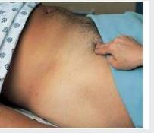
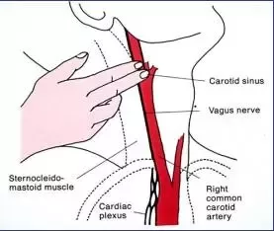
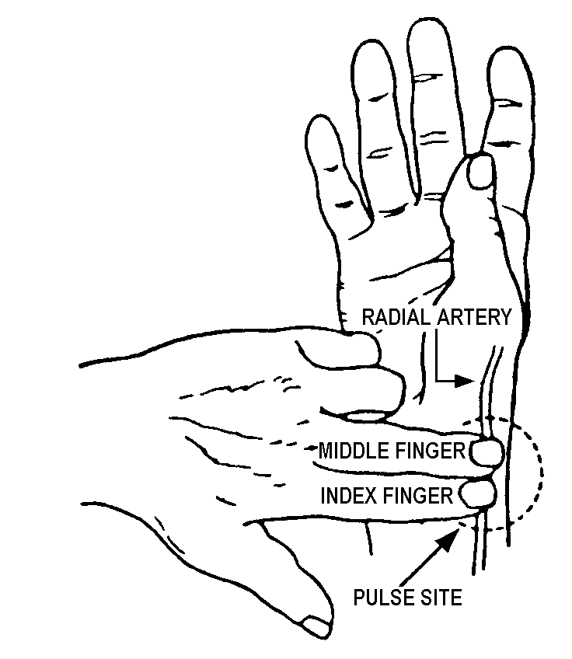
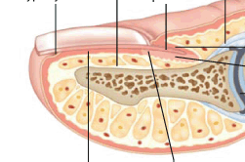
Pulse Points
Use finger pads not fingertips to check a pulse
Pads of the finger are more sensitive than the tips
Fingertip Not Sensitive
Hard to find in stressful situations
Finger pad
Very Sensitive

Slide 13
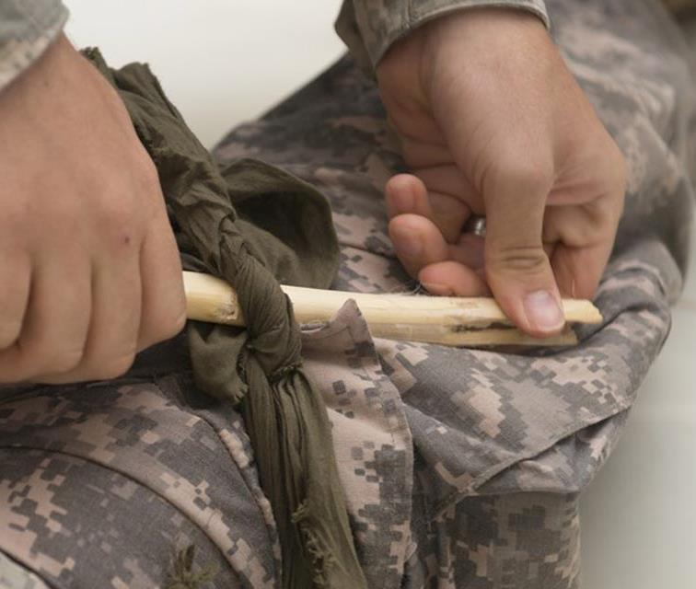
Bleeding
Use gloves to keep blood from contacting you (body fluids can transmit disease, Hepatitis B/C, HIV)
Direct pressure with whatever is available (tee shirt, shirt, 4X4s, battle dressing, gloved hand)
If spurting bleeding (artery), consider a tourniquet, improvised or commercial
  Place a couple of inches above the bleed
  Turn until bleeding stops
  Will be very painful but leave it in place
Improvised tourniquet can be made from clothing and a stick
Commercial tourniquets are cheap, keep on in vehicle, tractor, or other equipment, and in the first aid kit
The same is true for “battle dressings”

Slide 14
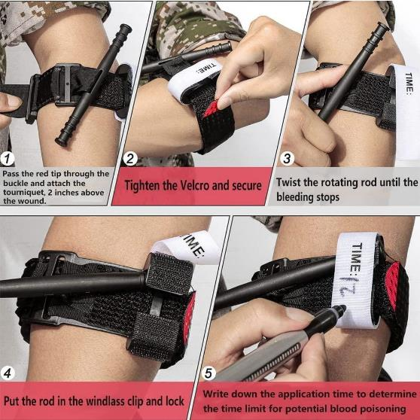
Application of a Commercial Tourniquet

Slide 15
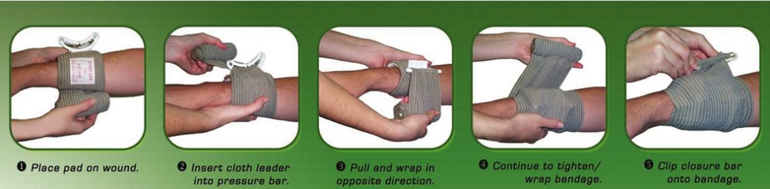
Using a “battle dressing”

Slide 16
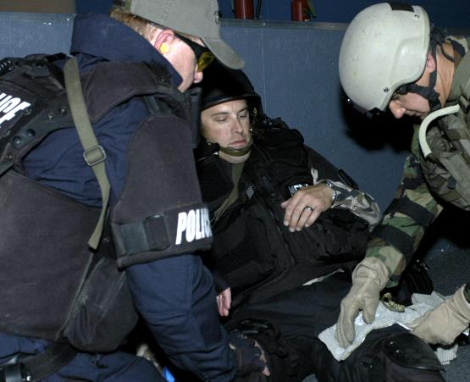
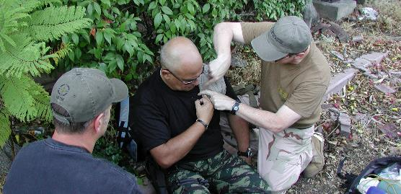
“Battle Dressings” can be used to stop bleeding in many areas

Slide 17
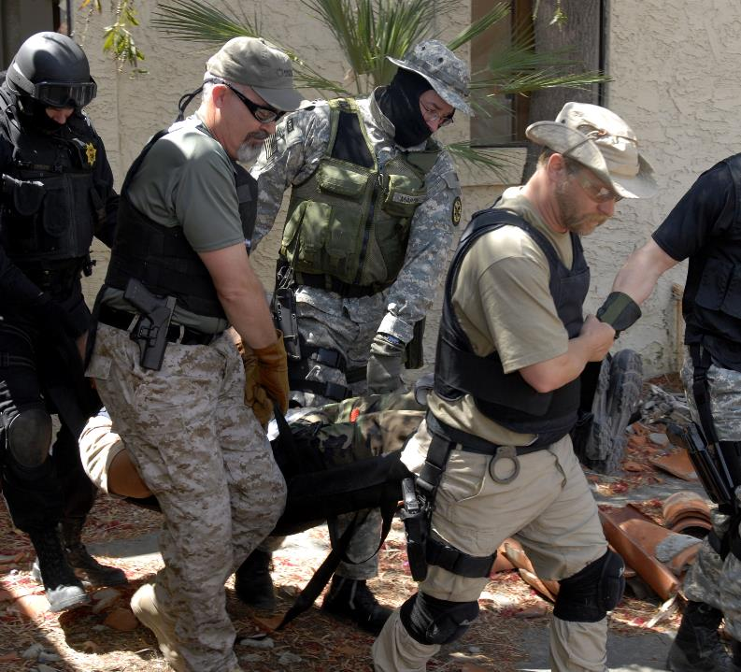
Persons located in rough terrain, or a danger area are hard to reach and move

Slide 18
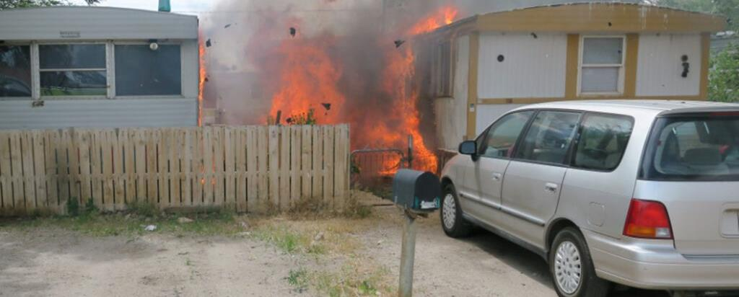
Structures on fire present serious inhalational and thermal burn hazards for those inside

Slide 19
Burns
Clean, non-adherent dry dressings are needed
Consider inhalational injury if the person was in an enclosed space
  If the person is hoarse, or
  Has smoke or soot in their nose, or
  Has a sore throat, then
  Prompt transport is required as the larynx and lungs can be injured
May irrigate the burn with cool tap water or saline prior to applying dressing if debris is present or to cool the burn
Air causes pain, keep the air out with a non-adherent dressing
DO NOT APPLY ANYTHING TO THE BURN SUCH AS BURN CREAMS, BUTTER, petroleum jelly, ETC.!
Remove jewelry, rings, watches, if the burn affects the hand or arm as swelling will occur
In cold settings be concerned about hypothermia in burn patients
Third degree burns, leathery brown/black skin, second degree burns blisters, first degree reddened skin, electrical burns many times 3rd degree
Any third-degree burn is critical, second-degree burn of face/neck, hand/feet, genitals is critical, and needs prompt medical attention
Usual Causes of Burn Death
First 24 hours – Inhalational Injury or comorbidities, trauma outside burn injury
24 to 48 hours – Electrolyte/Fluid or Metabolic Issues (May require multiple liters of IV fluid to replace fluid losses), comorbidities
48 to 72 hours and beyond – Infection or comorbidities

Slide 20
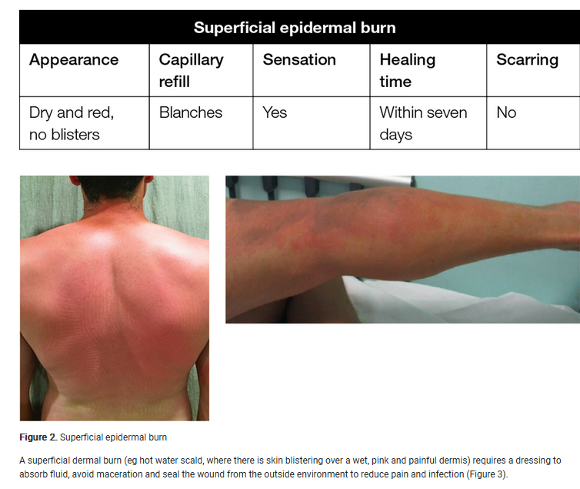
First Degree Burn
Some recommend blister debridement followed by 48 hours of nanocrystalline silver dressings
At 48 hours, management of burn injuries that appear large or deep should be discussed with a regional burn service, whereas smaller, more superficial injuries can be dressed with hydrocolloid, foam, hydrogel or alginate dressings
Complicated burn wounds and patients at higher risk of scarring, should be identified early to allow scar management to commence.

Slide 21
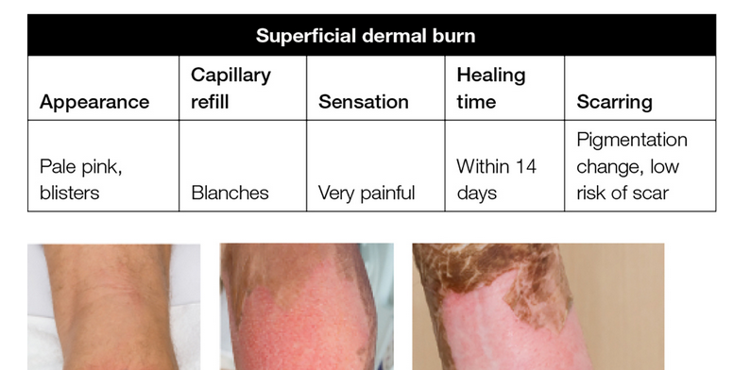
Second Degree Burn

Slide 22
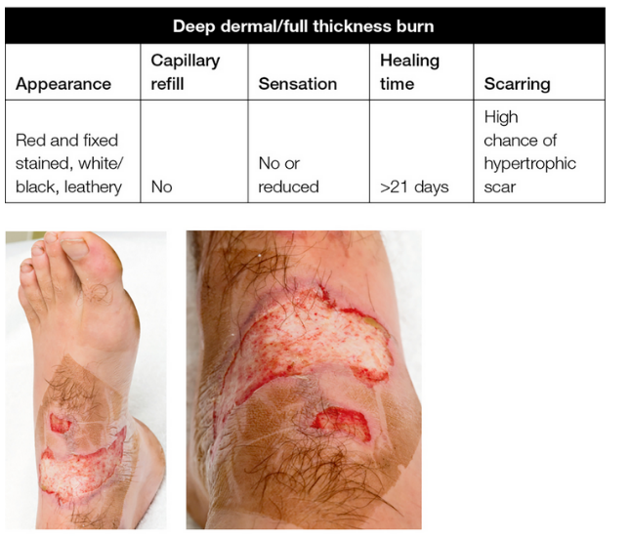
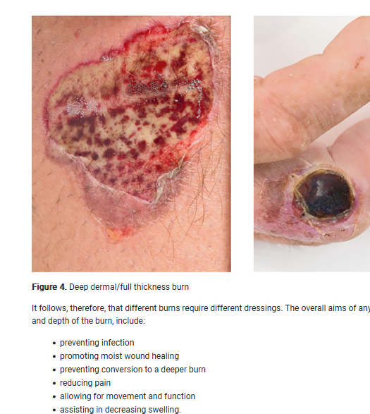
Third Degree Burn

Slide 23
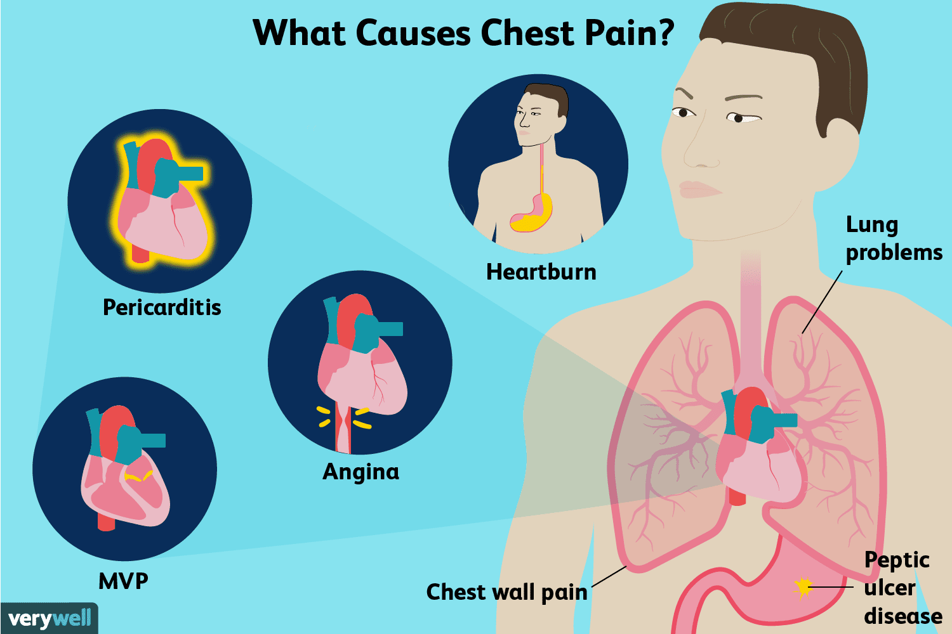
Chest Pain
Unexpected chest pain lasting more than two minutes, and
Unrelieved by movement, and
Is of a squeezing nature radiating to the jaw or arm, and
Is in a person 30 or older, or
Is in a person with a history or at risk for heat issues (Obese, high BP, diabetes, previous cardiac problems)
Call for help, or
Meet EMS at a predetermined location if response time is long
Heart Attack
Myocardial Infarction

Slide 24
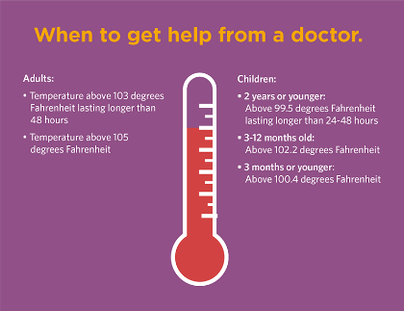
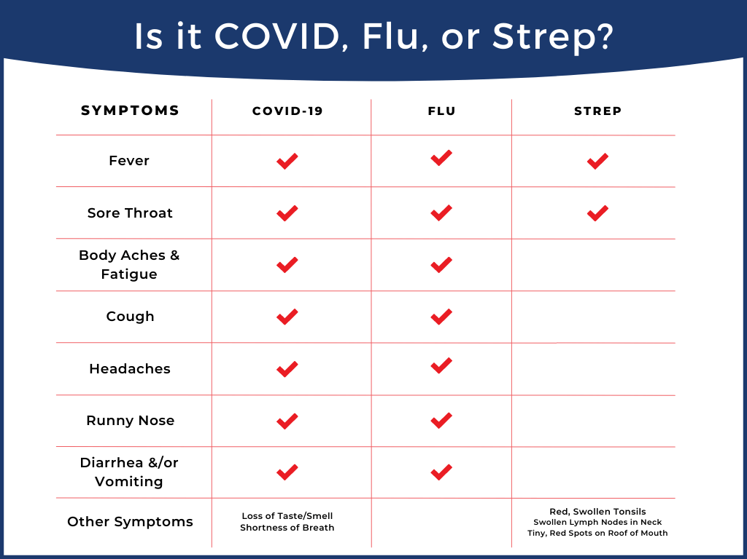
Febrile Illness
Common in children
Consider contacting a physician if temperature is above 102 degrees Fahrenheit (adult)
Consider OTC tests for influenza, COVID, Strep, which are the common three febrile diseases in children and adults (if available OTC)
If coupled with nausea, vomiting, and diarrhea, contact your physician as this may lead to dehydration

Slide 25
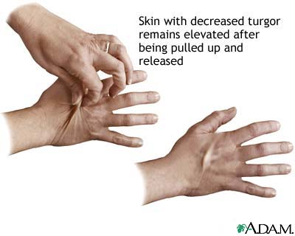
Nausea, vomiting, diarrhea, dehydration
Repeated vomiting and diarrhea will cause dehydration, especially in children
Keep track of the number of times and amount of fluid with each episode
Children very susceptible to dehydration
If prescribed, use an antinausea agent such as odansetron
If you can “pinch up” skin on the back of the hand and it does not rapidly lose its “tent,” dehydration is likely
Many recommend Pedialyte for adults and children
Keep fluids in the person
If not controlled consult a physician

Slide 26
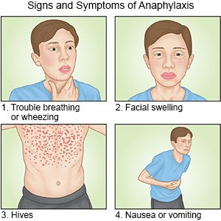
Stings and Bites
If allergic and stung by an insect such as bee, wasp, hornet, yellow jacket, etc., be prepared to use an EpiPen if breathing difficulty or swelling around the face/mouth/tongue occur
Remember the EpiPen buys at the most 15 – 20 minutes before it may be needed again
Call EMS and if response time is long meet them at a predetermined location
This is a life-threatening emergency!

Slide 27
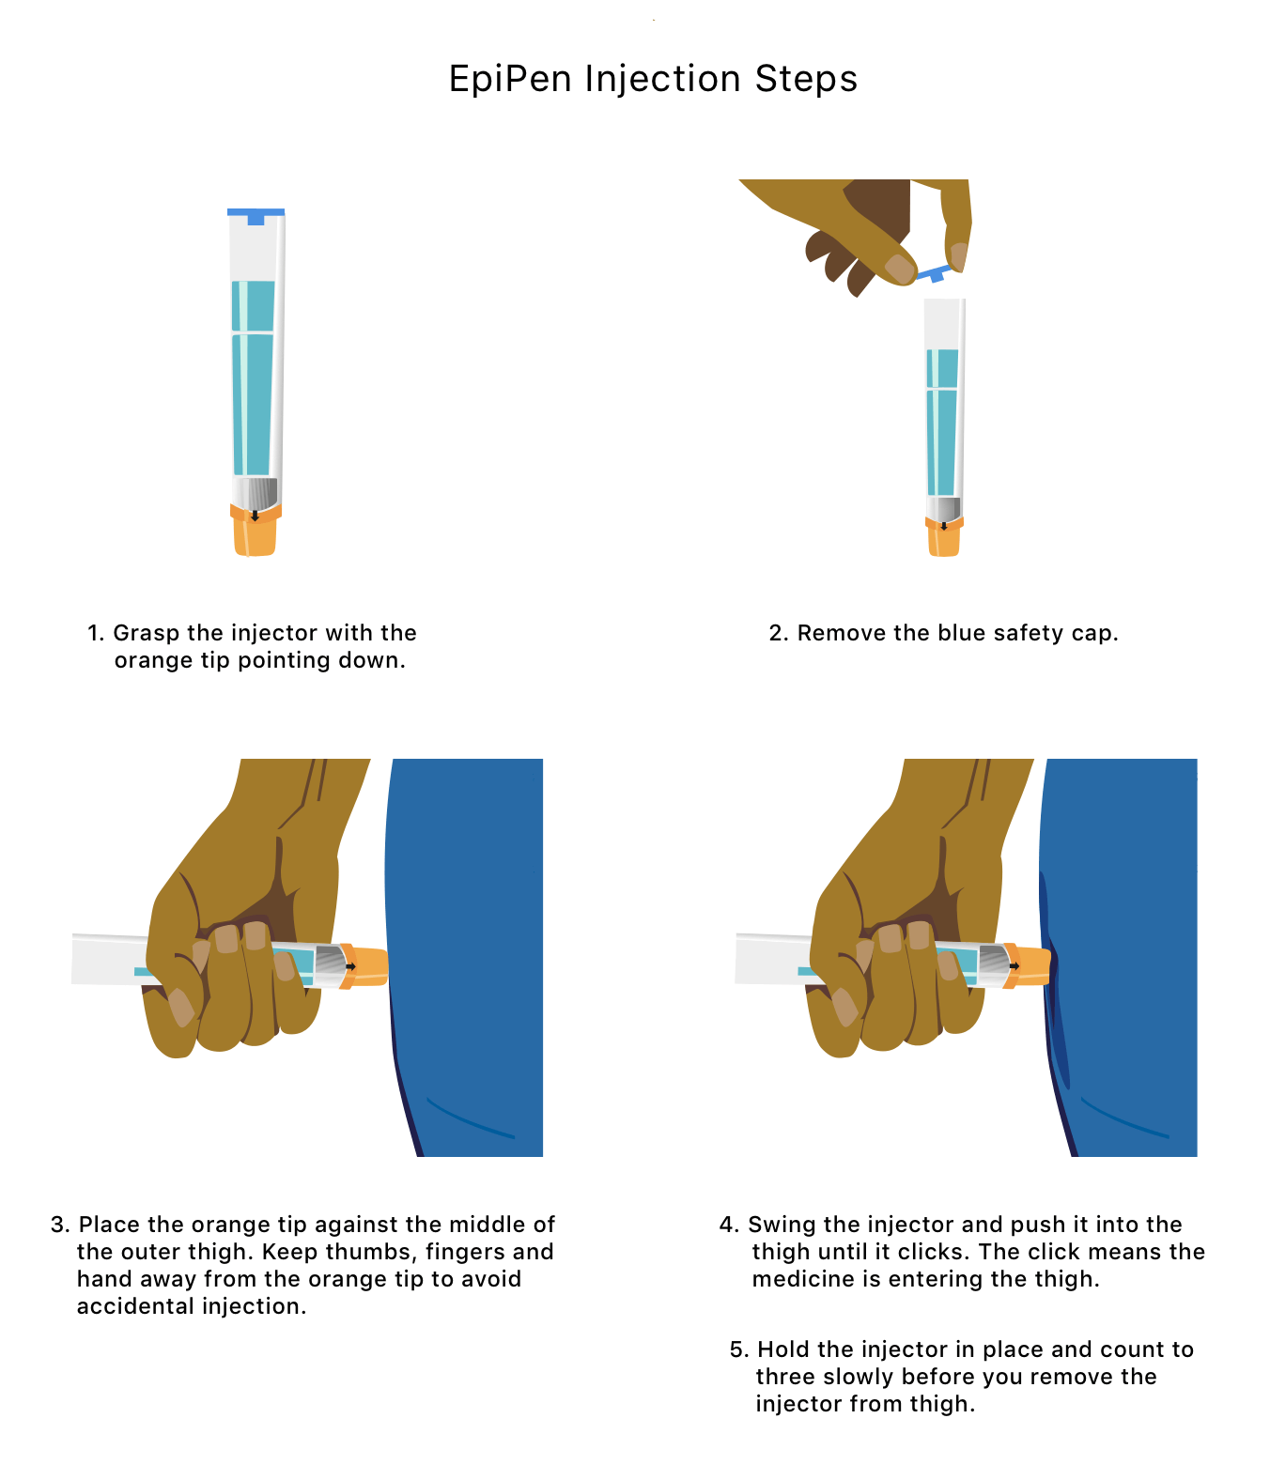
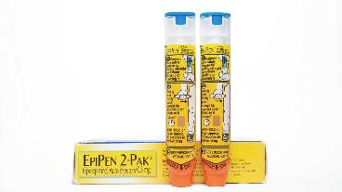
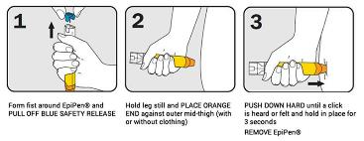

Slide 28
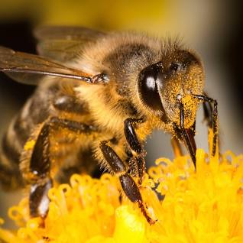
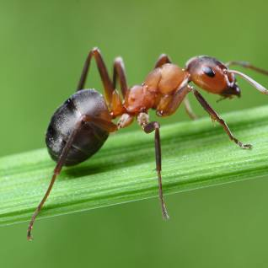
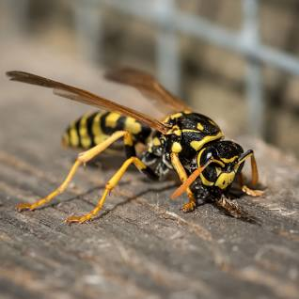
Bees are winged insects closely
related to wasps and ants,
known for their roles in pollination, can sting one time, roughly 1,000 stings to cause death from non-allergic deaths, usually do not attack in swarms where Africanized bees will attack in swarms
Ants are eusocial insects of the family Formicidae, unusual to cause allergic reactions
Family Vespidae - Yellowjackets and
Hornets, Paper Wasps; Potter, Mason
and Pollen Wasps, can sting multiple times, as can yellow jackets which are aggressive with the more potent of the venoms from this family, with allergic reactions common from yellow jacket stings
Some members of Hymenoptera

Slide 29
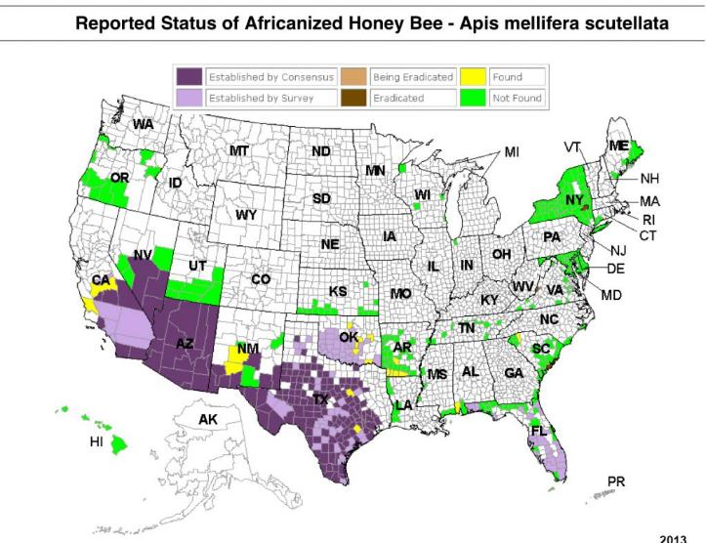
Africanized bees will defend their nests aggressively chasing intruders up to 1,000 feet and the entire hive, usually 60,000 bees or more, will respond. Their stings release a pheromone that attracts other Africanized bees to attack. Their range is the US is limited and a few attacks and deaths have been reported by the media. The best defense if attacked is to enter a structure or vehicle with air conditioning and cool temperatures. Firefighting foam quickly kills the bees, but they can defeat firefighting bunker clothing by entering any openings such as at the sleeves or under the bunker coat. Dry chemical fire extinguishers have also been used to suppress the bees as have CO² extinguishers, but one must remember the powder and gas is toxic to humans. Their gross appearance is identical to US honeybees requiring expert examination to confirm their type.

Slide 30
Selected Media Reports of Africanized Bee Attacks
A woman reaching for a mop in her car is stung more
than 200 times by a swarm of killer bees
By Ayana Archie and Brandon Griggs, CNN
Updated 2:22 PM EDT, Wed July 18, 2018
UAB professor helps rescue workers in swarm of thousands of killer bees by Alicia Rohan, July 25, 2019, Print Email
European honeybees may be in danger, but the Africanized honeybees, commonly called killer bees, are a danger – something a professor at the University of Alabama at Birmingham learned firsthand earlier this summer.
Olivia Affuso, Ph.D., was attending the American College of Sports Medicine’s annual meeting in Orlando, Florida, in June when she found herself in the middle of an attack of thousands of bees.
Posted at 5:26 PM, Aug 23, 2022
and last updated 7:24 AM, Aug 24, 2022
TUCSON, Ariz. (KGUN) — Monsoon is bringing more
issues than just flooding. This summer Africanized
honeybees are consistently attacking people in
Cochise County.
Man survives after suffering 20,000 stings in
horror killer bee attack
73-year-old man killed by Africanized bees disturbed by his bulldozer destroying an abandoned house in Albany, Georgia, 2010
According to the mom from Florida, her son, Austin Bellamy,
had climbed a lemon tree to trim it for a friend when he accidentally
cut into a beehive filled with killer bees. Austin, had used a ladder to
climb the tree. He then harnessed himself to one of the branches
at the top before he began trimming away. "When he started
cutting the branches, that's when the bees came out,"
says his grandmother, Phyllis Edwards, who witnessed the horrific
attack. In just a few seconds, his body was covered from head to toe
in a blanket of bees. Austin, who got stuck in the harness, was no
match for the angry swarm.
One man dead after hundreds of stings from Arizona bee swarm
Two people required hospital treatment after being stung
Large open hive thought to weigh 100lb found nearby

Slide 31
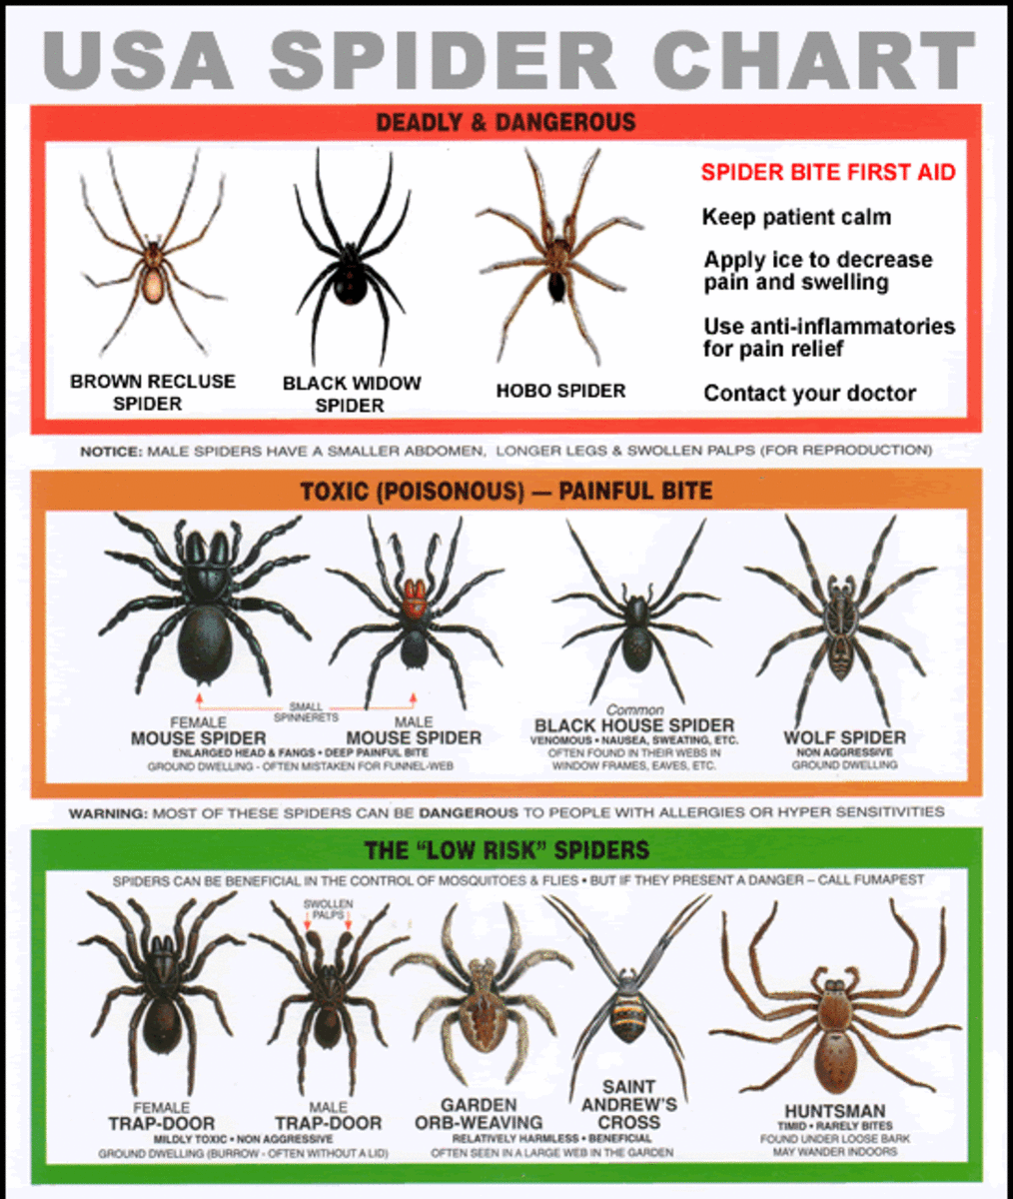
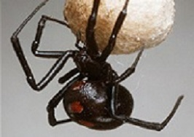
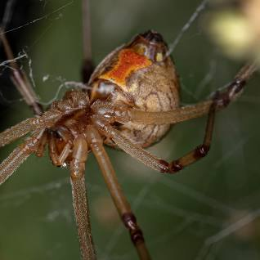
Arachnids
Black Widow (Latrodectus mactans) and Brown Widow (Latrodectus geometricus), found outside usually in debris piles. Painful bites with abdominal spasms are common. These spiders are active at night. They prefer dark corners or crevices, like garages. They only bite when disturbed.
Symptoms
The black widow spider makes a venom that affects the nervous system. Some people are slightly affected by it, but others may have a severe response. One may feel severe pain, burning, swelling, and redness at the site. If this occurs, contact a physician.

Slide 32



Ulcer/Necrosis: After a week or more following a brown recluse bite, you will notice an open sore (an ulcer) with a breakdown of tissue (necrosis) which may take months to heal. Brown recluse bites become necrotic where the tissue around the bite dies and sloughs off. The main chemical within the venom of the brown recluse is the enzyme sphingomyelinase D. Unlike most venoms that attack the nervous system, this enzyme works to destroy cell membranes. Brown Recluse bites usually present as non-healing ulcers. Found in closets in clothes or dark spaces. Many bites occur when spiders are trapped in clothes donning or in shoes.
Brown Recluse (Loxosceles reclusa)

Slide 33

Animal Bites
Is the animal possibly rabid?
Feral or wild animal
Canine
Skunk
Raccoon
Medical treatment and possibly rabies vaccine/IG
Otherwise
Bleeding control
Wash wound with soap and water
Seek medical attention (Includes Human Bites)
Bat

Slide 34

More than one hundred species are found in North America
Some are venomous
Per CDC roughly 45,000 snakebites annually in US
  Some 11,000 from venomous snakes
  Less than a dozen fatalities annually
  Snakebite locations are usually the hands and feet
  Facial snakebites involve males and alcohol use as a rule
The venomous snakes fall into two groups:
  Coral Snakes (Neurotoxic venom, Micrurus fulvius)
    Fangs fixed in rear of mouth
    Black Blunt Snout like head
  Pit Vipers (Hemotoxic venom)
    Flat Triangular shaped head
    Has “pits” in head which are heat sensing
    Extendable fangs in rear of mouth
    Include Rattlesnakes, Cottonmouth (Water Moccasin), Copperhead
  Same Antivenin used for every Pit Viper
Snake bites require medical attention
If the bite immediately is painful and begins to swell, this is likely a venomous pit viper snake with time of the essence to minimize tissue damage with antivenin, which costs about $8K per vial, with eight to 10 vials used in many envenomations

Slide 35

Copperhead (Agkistrodon contortrix), a pit viper, widespread throughout the United States
Copperhead bites rarely deadly
Medical attention is required
Usually, a tan to copper color but can vary widely in coloration by region
Common are the patches of hourglass markings on its back with a copper-colored triangular looking head
Copperhead typically ranges from Massachusetts to Nebraska to Texas and the southeast US
Note flat triangular head

Slide 36


Coral snake (Micrurus fulvius) venom is a powerful neurotoxin
The coral snake is identified by the red, yellow, and black bands that ring the length of its body
Has a Blunt Black Snout like head
Adage, “Red and yellow kill a fellow, Red and Black, venom lack”
Coral snake colors are always red, yellow, then black
The King Snake or Milk Snake with no venom is similar looking red snout
Coral snakes are secretive and hide under debris, rotten trees, and will run to avoid human contact
If a coral snake is disturbed it may whip its rounded blunt black snout side-to-side in what appears to be a random motion but is a display warning the snake is about to bite
The coral snake’s rear fangs make it hard to bite and deliver venom
Most hospitals do not keep coral snake antivenin in stock
Blunt Black Snout, Coral Snake, Micrurus fulvius
Red Snout, King Snake or Milk Snake, Lampropeltis triangulum

Slide 37


Note “red on yellow” coloration with thin yellow stripes, and a black snout
Coral Snakes
Nothing to play with!
Black Snout

Slide 38

As Bill Engvall would say, “Here is your sign.”
An Alabama father of six is paralyzed and fighting for his life after being bitten by one of the deadliest snakes in the country.
Jeffrey Phillips’ children discovered the reptile outside of his Gilbertown, Alabama, home last week, according to WTOK. He decided to hold onto the snake — which he thought was a harmless kingsnake, WALA reported — to give to his older brother, who used to own reptiles as pets.
“Jeff went to pick it up and told him he didn’t really need to pick it up, but he did and he actually was holding it and he let the children touch the snake,” his mother, Judy Kell, told WTOK. “Not knowing that it was a coral snake, he thought it was just a kingsnake.”
After the red, yellow and black striped snake bit him, Phillips was paralyzed and rushed to nearby Anderson Hospital, where he is currently being treated in the intensive care unit, Kell told WTOK.

Slide 39


Coral Snake, note black snout
Note long extendable pit viper fangs

Slide 40



Pit viper hemotoxic venom rapidly causes swelling, digestion of blood, and tissue of the affected area

Slide 41



The Cottonmouth (Agkistrodon piscivorus), also called “water moccasin,” is a fast, aggressive pit viper, and readily attacks intruders
“Water moccasins” have a thick, heavy body with a thin tail
Colors are brown, olive to grayish/black with a thin tail
They have flat-topped triangular head like other pit vipers
Their bite can be fatal
Cottonmouths tend to stand its ground may display their “cotton colored” mouth from whence their name derives
They may also attack rather than retreating or hiding as other snakes sometimes do
Usually found in wet areas, creeks, swamps
Note Cotton Colored Mouth
Note flat topped triangular head

Slide 42

Snake bite to face by Water Moccasin
(Yes, ethanol was involved and as Bill Engvall would say, “Here is your sign”)

Slide 43



Rattlesnake, a pit viper with a flat large triangular head
Multiple Species!
Found through out the US this snake can be deadly
It may rattle prior to biting
They have large extendible fangs which can penetrate most footwear
The Eastern Diamondback (Crotalus adamanteus) and Western Diamondback (Crotalus Atrox) Rattlesnakes can deliver a large amount of venom deep into the flesh
This snake is also known for standing its ground and can swim
Timber Rattlesnake (Crotalus horridus) is in abundance and is commonly found on wooded hillsides and rocky outcrops and can be deadly
Size is not a determinant of deadliness!
Timber Rattlesnake,
Crotalus horridus
Note Flat triangular shaped heads
Eastern Diamond Back Rattlesnake,
Crotalus adamanteus

Slide 44


Taking the Wrong Medication
If an adult and the medication has label information, read the label information to determine what to do
One can call Poison Control and this well-trained group can assist you
If the ingestion is by a child, remember many of the adult medications are deadly
  Immediately call for EMS assistance
  Call Poison Control (Look up the number now so you will have it!)
  Calcium channel blockers are particularly dangerous for children
When in doubt, seek medical attention!

Slide 45

When to go to the physician or hospital
In many rural areas, serious cuts are sutured on site, bones are set, children delivered, antibiotics and IV fluids administered, and other medical procedures are performed on humans as well as animals
This is partly because of the cost of medical services, the inherent distrust of medical providers by some rural residents, lengthy travel times, and the fact these procedures and others are performed routinely on farm animals
If an injury involves the need to suture a wound, chest pain, possible fractures, or an underlying occult injury may exist such as internal bleeding, or a head injury with loss of consciousness, seek medical attention
One concern is that the person has an up-to-date tetanus vaccination in cuts
Antibiotics may cause a serious allergic reactions and the tools/medications used for animals may not meet the stringent criteria for human use, and humans have a different anatomy/physiology than do animals
This is also likely a criminal violation of practicing medicine without a license
Adults with sustained fevers of 102F or higher, seek medical attention
Any severe pain requires medical assessment by a physician!

