Slide 1
Tactical Medicine Essentials
“Tacmed Essentials”
TK Use TACDA
Colonel James Smith,

Slide 2
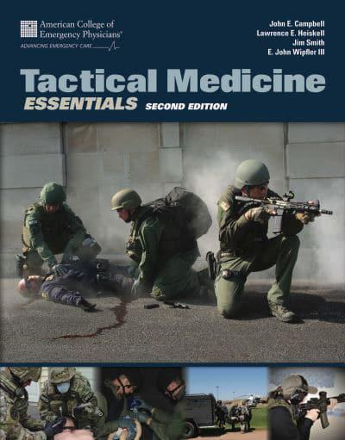
Tactical Medicine Essentials
Endorsed by
American College of Emergency Physicians
Primary text used by the only Homeland Security approved tactical medicine program
International School of Tactical Medicine
In use in Japan, Oman, South Africa, Saudi Arabia, Germany, UK and throughout the US.
More than 100 peer reviewers and seven years to produce.

Slide 3
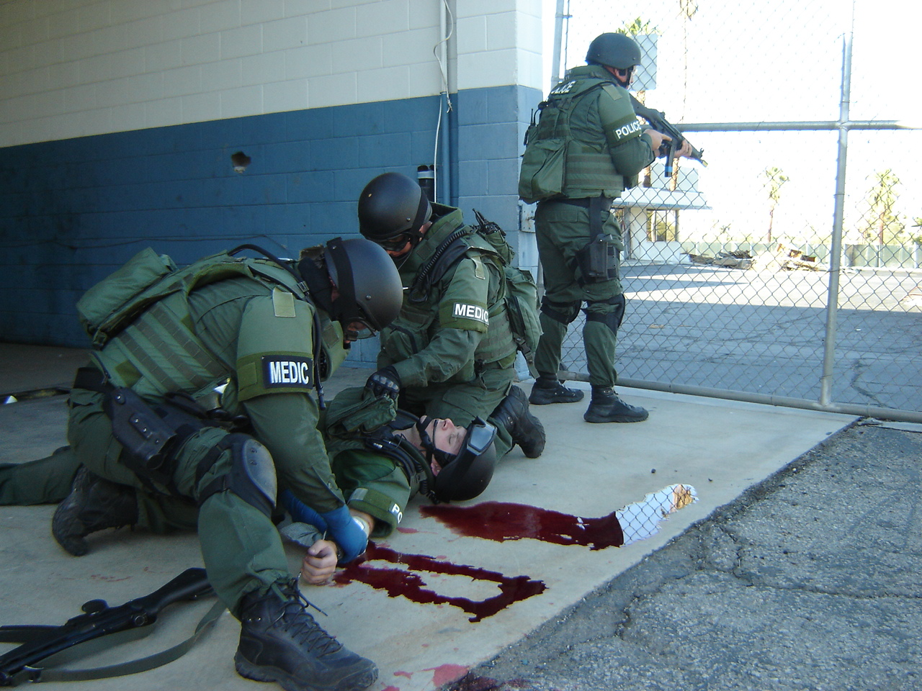
TaCmeD
Essentials
INTRODUCTION
Notes:
Instructor Notes: Tactical Medicine Essentials is a course that was designed to teach how to “tactical medics” how to best support a tactical or special operations team. It may be called “TacMed Essentials”.

Slide 4
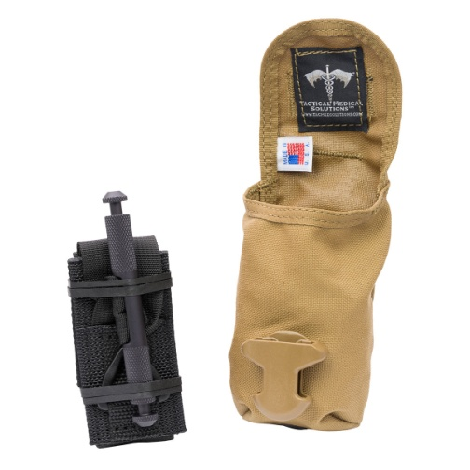
Essential Emergency Medical Gear
Follow the standards of your area.
Level One gear:
  Used by personnel exposed to gunfire
  Carried in pouch attached to body
  Allows for immediate self-aid and buddy-aid
  Called an individual first aid kit (IFAK)
  Basic trauma kit (at least a TK)
  Preferably several items beside TK
  OLAES or Israeli dressings

Slide 5
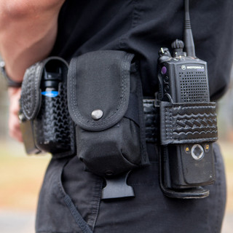
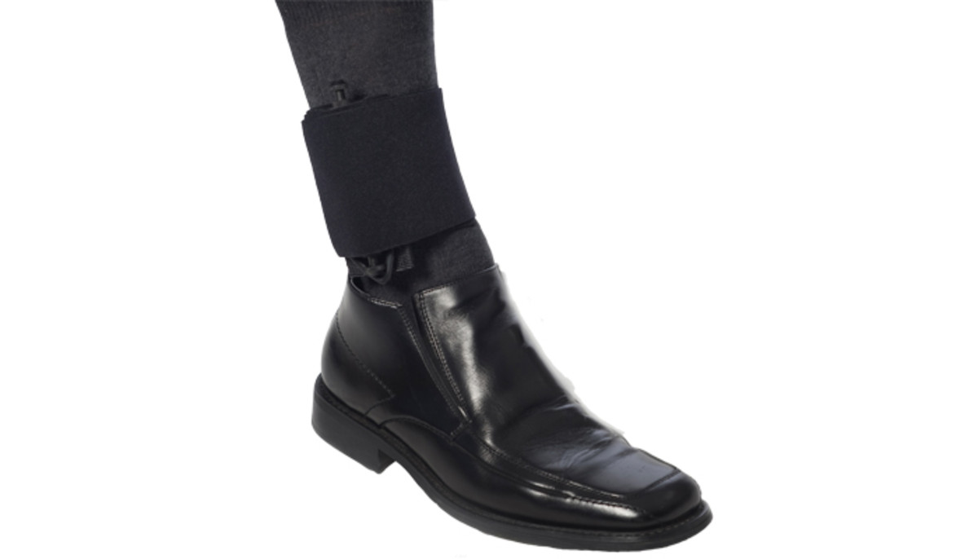
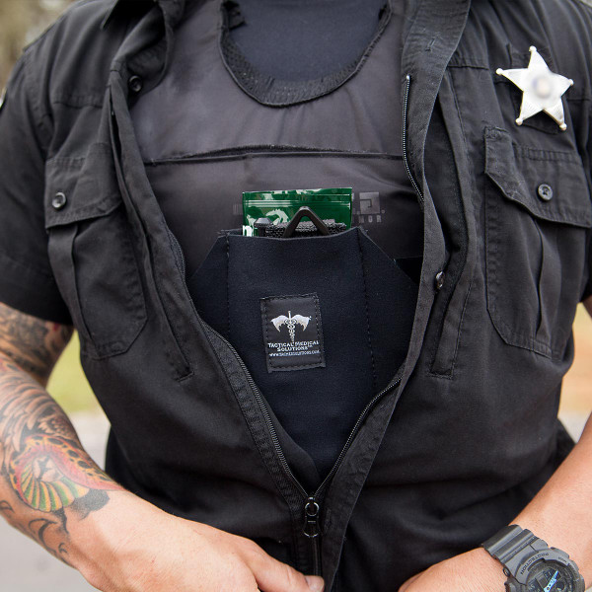
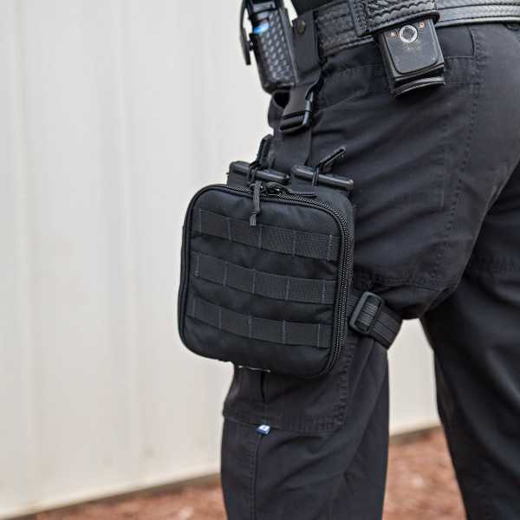

Slide 6
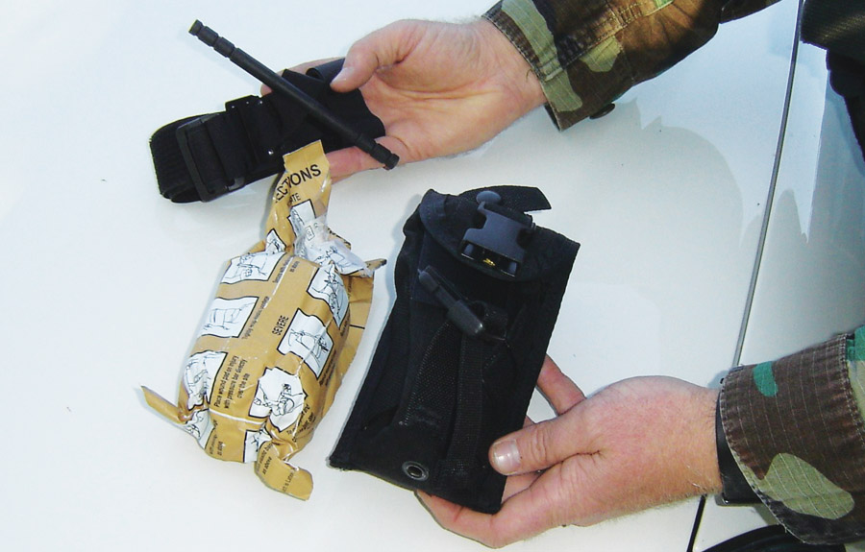
Essential Emergency Medical Gear
An IFAK should be carried always.

Slide 7
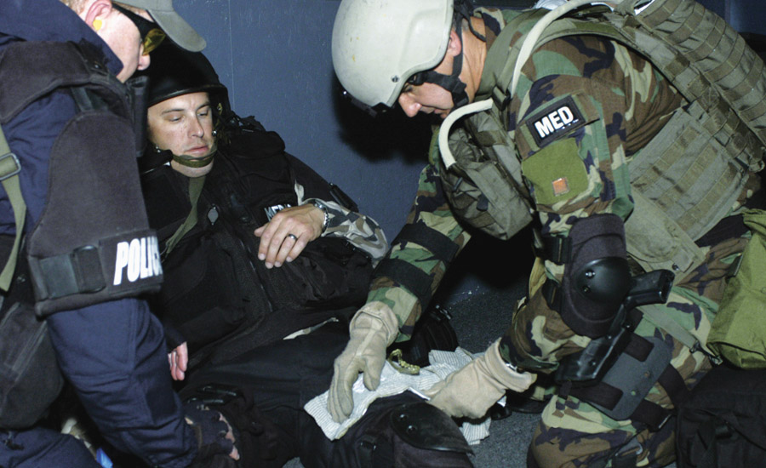
Tactical Medical Supplies
Tactical compression bandages are an important item used to control bleeding.

Slide 8
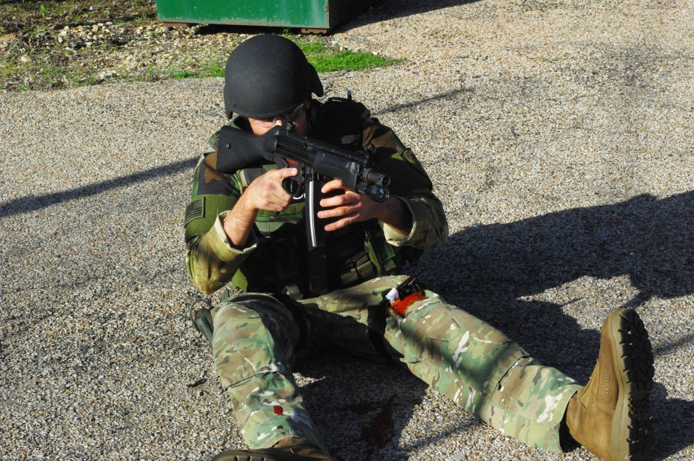
Tactical Medical Supplies
Tactical tourniquets can prevent the number one cause of preventable death in combat: extremity hemorrhage.
  Highly recommended that they be carried those potentially exposed to gunfire including hunters and on the firearm range.
  Can be improvised from clothing or other material if necessary
  Allows person
  to stay in
  the fight!

Slide 9
Scene Safety and Priorities
Priorities:
  Your own personal safety and medical care
  Safety and care of your teammates
  Care of other casualties:
    Hostages
    Bystanders
    Suspects
  Maintain an awareness of the situation around continuously. (360 degrees, full circle)

Slide 10
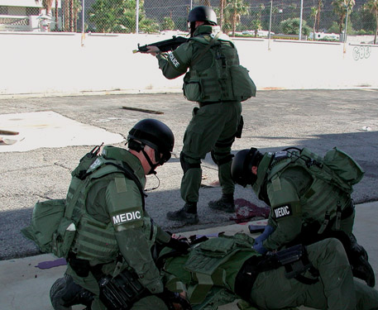
Someone must watch “6”
Ideally, someone provides security while others provide care.
Make certain “6” is covered

Slide 11
What is a good way to memorize your correct priorities?
Mnemonic:
“Call – A – CAB – N – Go – Hot”

Slide 12
Tactical Patient Assessment:
Call-A-CAB ’N Go
Call: Call out for help and communicate.
A: Abolish threats (simultaneous with above).
CAB: Circulation (stop bleeds), Airway, and Breathing.
N: Perform Neurologic status check.
Go: Go rapidly to the best medical facility.
Hot: Prevent hypothermia, keep them “hot.”
Easy to remember mnemonic

Slide 13
Call / Communicate
Call / Communicate any attacks by suspects.
  Use voice, radio, hand signals, cell phone, other.
Call out for appropriate help to deal with situation:
  Call to others to obtain resources needed and appropriate transportation
  Let others know what is occurring

Slide 14
A: Abolish Threats
Abolish threats:
  Must be done before initiating care
  Self defense if needed
  Take responsibility for your own safety
  Avoid “no win” high risk rescue attempts
  Let the dead stay (Binocular examination, hand signals by wounded)
  If high threat environment, then either:
    1) Extract the casualty to hard cover (masonry wall)
    2) Bring hard cover to the casualty (armored vehicle, etc.)

Slide 15
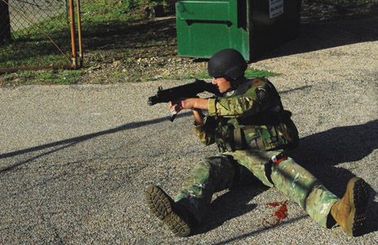
A: Abolish Threats
Threats to be abolished:
  Include threats from shooter(s)
  The Injured should have a combat mindset and remain in the fight as best and if possible.
  Watch words, “Stay in the fight!”

Slide 16
A: Abolish Threats
Threats to be abolished: (continued)
  Needless rescue (dead)
  Risk of further gunfire (move to hard cover or bring hard cover to patient)
  Risk of secondary explosions, suicide bombs
  Risk of blood-borne pathogens
  Risk of injury from HazMat/WMD agents
  Risk of confused persons (in hypovolemic shock, head injury)
  Fratricide or “blue on blue” incidents
  Risk of armed suspects

Slide 17
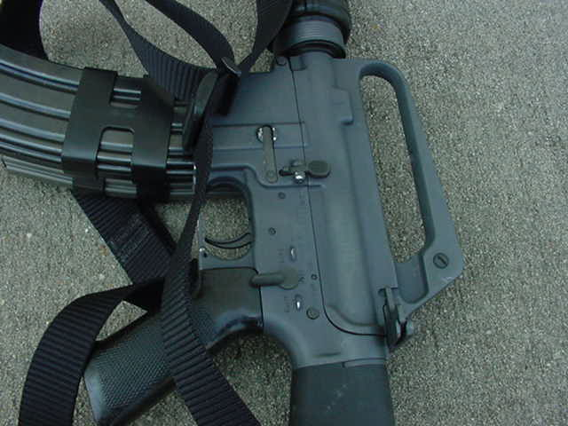
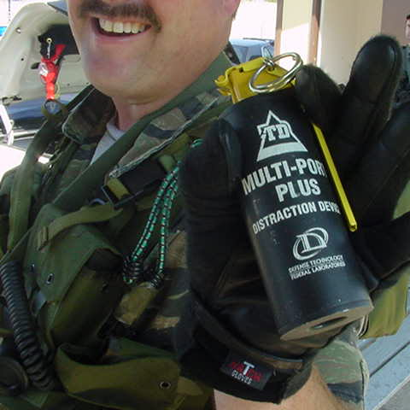
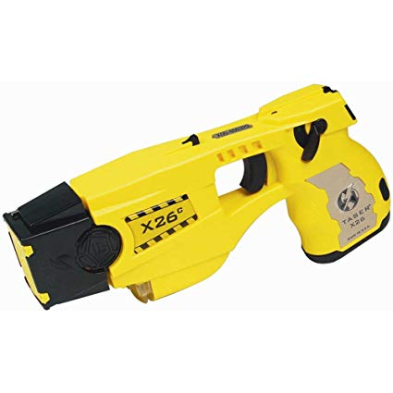
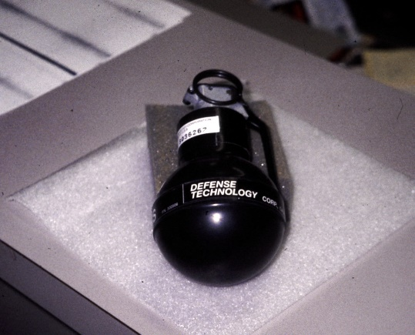
A: Abolish Threats
Threats to be abolished: (continued)
  Threats from seemingly innocent people
  Threats from lethal weapons (firearm safety ON)
  Threats from booby traps

Slide 18
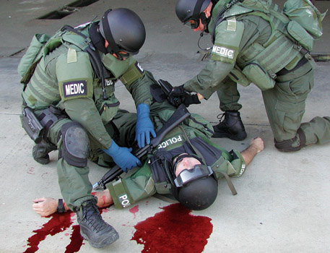
A: Abolish Threats
Before initiating medical care, remove and secure weapons from any critically injured person with a decreased level of consciousness (out of the fight).
If person is alert, do not take guns away!

Slide 19
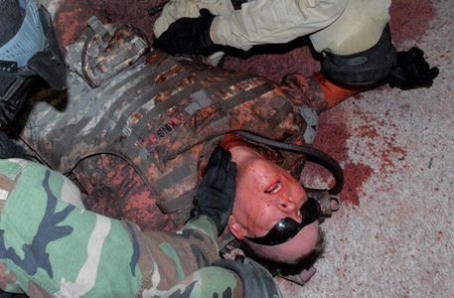
CAB: Circulation, Airway, and Breathing
In the tactical environment, circulation is assessed and managed first because of the high risk of bleeding to death or cardiac arrhythmia. Breathing is a second.

Slide 20
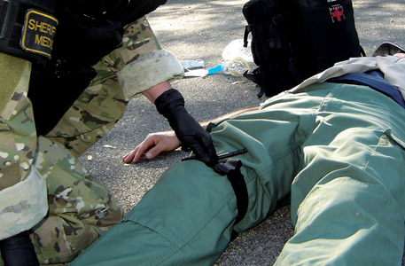
Circulation
Stop any significant external extremity bleeding by applying a compression dressing or tourniquet.

Slide 21
Circulation
Assess pulse presence and adequacy.
If unresponsive, check carotid pulse first.
If no pulses, consider CPR and use of AED.
  In tactical environment with traumatic full arrest, always question the risk-to-benefit ratio of CPR
  Declare dead if multiple casualties and obvious death
  Follow local protocol for obvious death in MCI setting or tactical setting

Slide 22
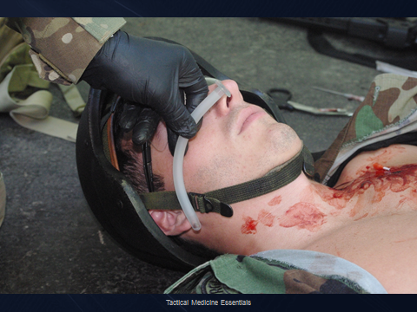
Airway
Determine if patient is moving air.
Be alert for airway obstruction.
If you identify an airway problem:
  Stop the assessment process and correct it !
  Obtain a patent airway!
If multiple victims, consider placing them onto their side in the ‘recovery position,’ which allows the airway to remain open.

Slide 23
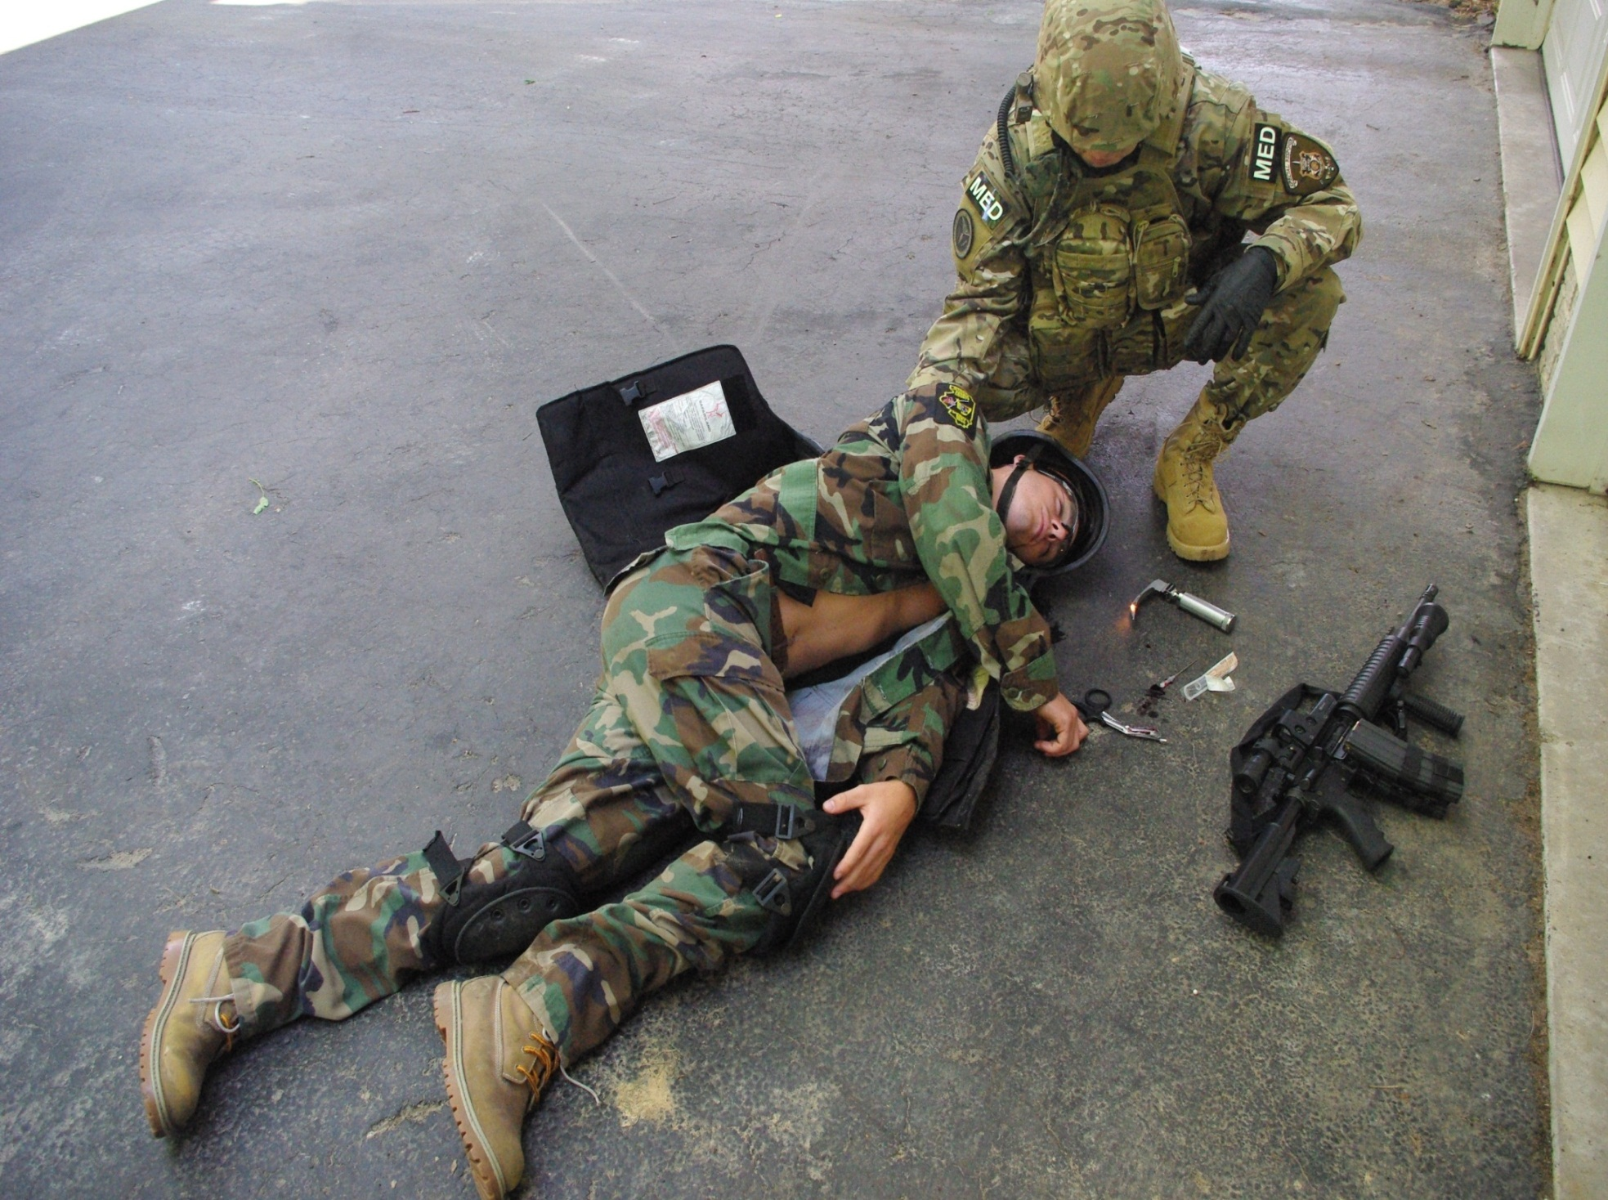
Recovery Position:
-Decreases airway obstruction
-If casualty vomits, less likely
to choke / aspirate in recovery position
-Good position if the casualty is left alone

Slide 24
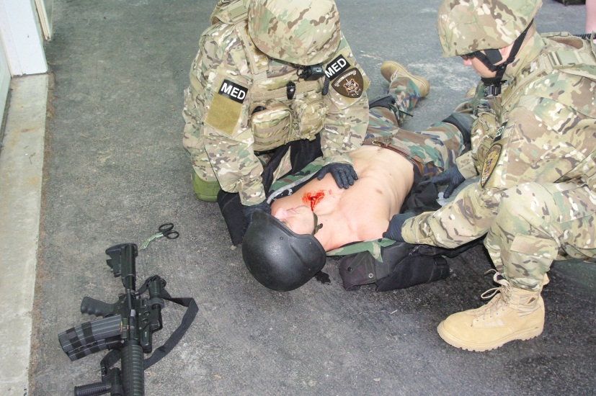
Breathing
Watch patient’s chest rise and fall. Injury? GSW?
Feel for air through mouth and nose.
Listen to breath sounds (if conditions warrant it).
Assess respiratory rate and rhythm.
Observe effort required for patient to breathe.

Slide 25
’N: Neurologic Status Check
Perform a rapid neurologic exam.
Ascertain gross level of consciousness using the AVPU scale:
  A: Alert
  V: Responsive to verbal stimuli
  P: Responsive to pain
  U: Unresponsive
If altered level of consciousness, check pupils.

Slide 26
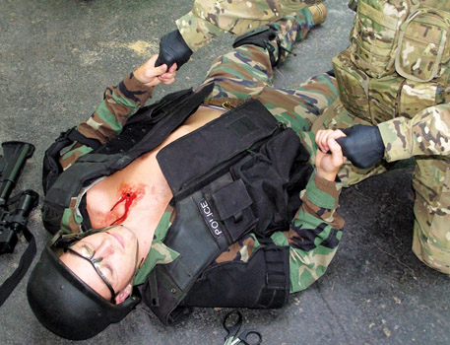
’N: Neurologic Status Check
If the patient is awake, perform a quick strength and sensation assessment of the arms and legs… “squeeze my hands, wiggle your toes.”

Slide 27
Go
Determine if you have a ‘load-and-go’ situation
  If so, Go!
  Critically injured patients often need an operation or intensive care unit rapidly
  Move quickly… provide stabilizing care en route
  Consider spinal movement restriction / spine board and cervical collar if patient has a spinal cord injury or if at high risk for injured spine

Slide 28
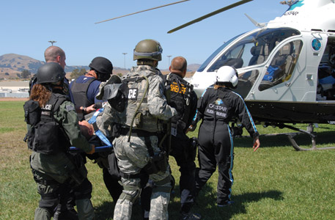
Go
A load-and-go patient needs to be transported to a hospital immediately and rapidly, so an air evacuation may be necessary. Know how.

Slide 29
Go “Hot”
Can use “Hot” as a reminder… to keep your patients warm and prevent hypothermia.
Hypothermia kills.
Trauma patients with hypothermia (temperature < 95°F) have a higher death rate. Prevent this.
  Use heat loss reducing techniques (Mylar blanket, bivy covering)
  Dry the patient
  Warm the patient

Slide 30
Low threat – ‘warm zone’
After behind hard cover or inside an armored vehicle that rescued the casualty = 2nd zone.
Once casualty is behind hard cover, a TMP may move to or be brought forward to assess casualty(s), provide stabilizing medical care.
Sequence: Hit by gunfire, extract (by self or dragged by partner) to a nearby masonry wall (hard cover), apply TQ, then evacuate (drag / stretcher) to the cold zone casualty collection point (CCP) for stabilizing med care, then tactical evac / transport (TacEvac) to hospital.

Slide 31
Call A CAB N Go Hot = TPA
TRAUMATIC or MEDICAL Collapse?
CAB = works for both med and trauma victims.
If medical = non-traumatic without a pulse…
  Why? Ventricular fibrillation or ventricular tachycardia
  Answer = Obtain and apply an AED (defibrillator)
  “C”
  C=circulation ➔ ‘Current’ ➔ electrical shock to heart
  C=circulation ➔ ‘CPR’ ➔ start CPR / Compress chest
If traumatic injuries, “C” = Control killer bleeds.

Slide 32
Hemorrhage
External bleeding:
  Usually controlled by direct pressure or compression bandage when rescuers can monitor closely.
  If alone without help and if shot, or cut on arm or leg, with a substantial bleed, the first solution is a tourniquet (TQ).
Internal bleeding:
  Likely not controlled until a surgeon stops it in the OR
  Must rely on signs and symptoms to detect
  Assess and Think?
  Was injury mechanism severe?

Slide 33
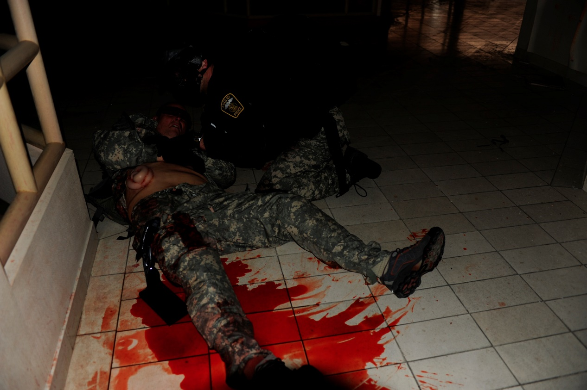
“C” = circulation
Compress killer bleeds!
If torso trauma, cover any
exposed intestines and go to the operating room.
“Yes, those are intestines!”

Slide 34
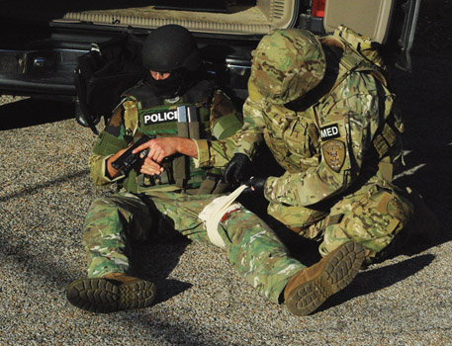
Controlled Versus Uncontrolled Hemorrhage
External extremity bleeding will be controlled by either pressure / compression, or tourniquet.
You can and
will control
extremity
bleeding!

Slide 35
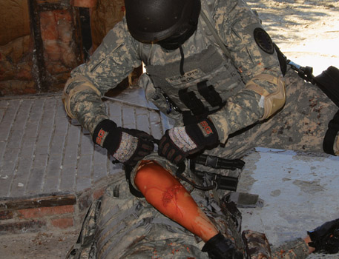
Hemorrhage Treatment
After gunfight, expose any sites of bleeding to identify the injury site and mechanism of injury.
-May pull back clothing
-Cut clothing with scissors
-Cut clothing with knife
-Remove clothing
Self-aid extremity wounds:
Simply apply a TQ
Do not need look at wound
during a gunfight!
Courtesy of Bohdan T. Olesnicky, MD

Slide 36
Principles of Tourniquet Use
Tourniquet is indicated for extremity wounds when:
  If alone - no nearby help
  Arm or leg wound that does not stop bleeding with use of a compression dressing or other technique
  Severe arterial bleeding from arms or legs
  Amputation of arms or legs.
  Geriatric patient (older than 65) with continued bleeding

Slide 37
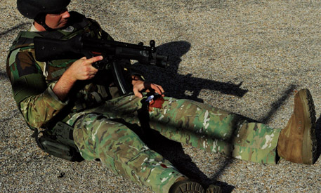
Principles of Tourniquet Use
A person alone and sustains a substantial extremity injury!
Should finish and win the gunfight, and then self-apply his or her own tourniquet ASAP!

Slide 38
Principles of Tourniquet Use
How long can a tourniquet be left in place?
  Answer: 3 hours or more
    Tissue and nerve damage are rare if TQ < 2–3 hours

Slide 39
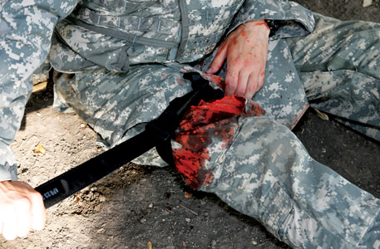
Procedures for
CAT or SOFTT tourniquets
Slide or wrap TQ around upper arm or leg.
Adjust the friction adaptor buckle until the tourniquet is snugly in place.

Slide 40
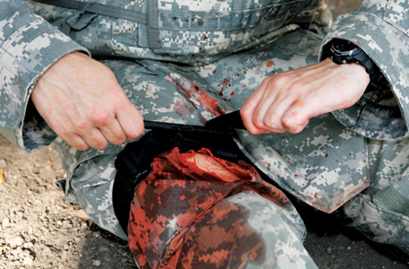
Tourniquet Procedures for
CAT or SOFTT
Twist and tighten the windlass rod, and then lock into place in place. Mark time applied. Painful!

Slide 41
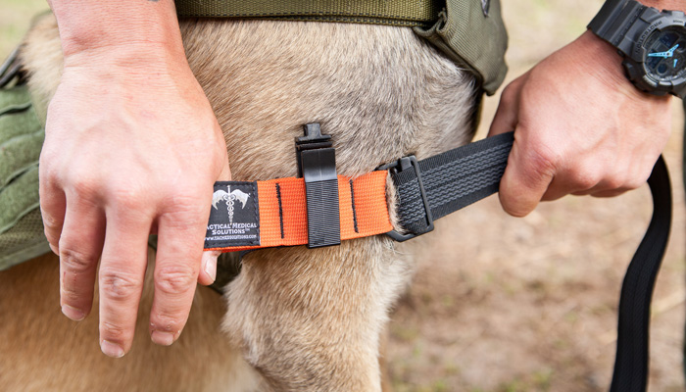
Canine Tourniquet
In use

Slide 42
Improvising a TQ:
(If no commercial tourniquet is available)
Improvised Tourniquet:
Cut fabric from patient’s pants / clothes, or use other appropriate material (bed sheets, curtains).
Wrap fabric around extremity twice.
Tie the ends together with a secure knot.
Put stick or rod under loop of fabric, or tie it on top of knot, and tie ends of bandage over it in square knot.

Slide 43
When No Commercial Tourniquet Is Available (cont)
Use the stick or rod as a handle (windlass) and twist it to tighten tourniquet.
Check that skin is not pinched or damaged by twisted cloth as it tightens.
Stop bleeding – arterial and venous.
Secure stick in place. Prevent loosening.
Write “T” or “TK” and time on a piece of adhesive tape, triage tag, or patient’s forehead.

Slide 44
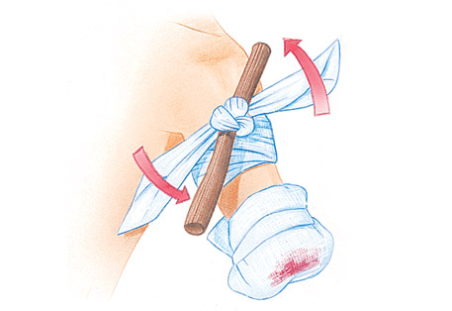
When No Commercial Tourniquet Is Available
Key element:
  Twist the stick or rod of the improvised tourniquet until the bleeding has stopped

Slide 45
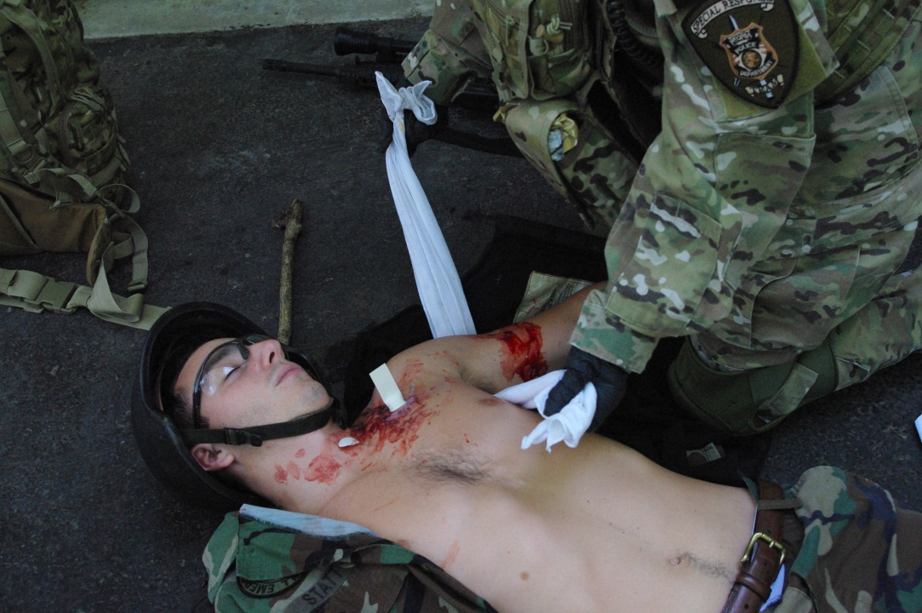
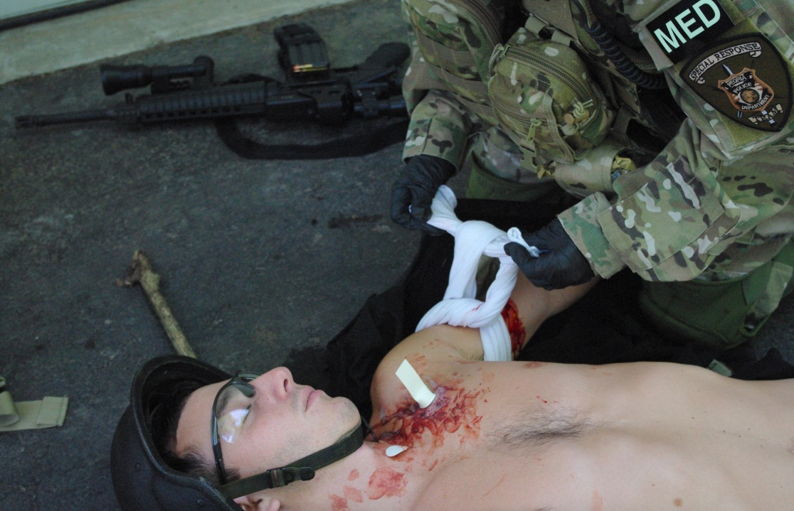
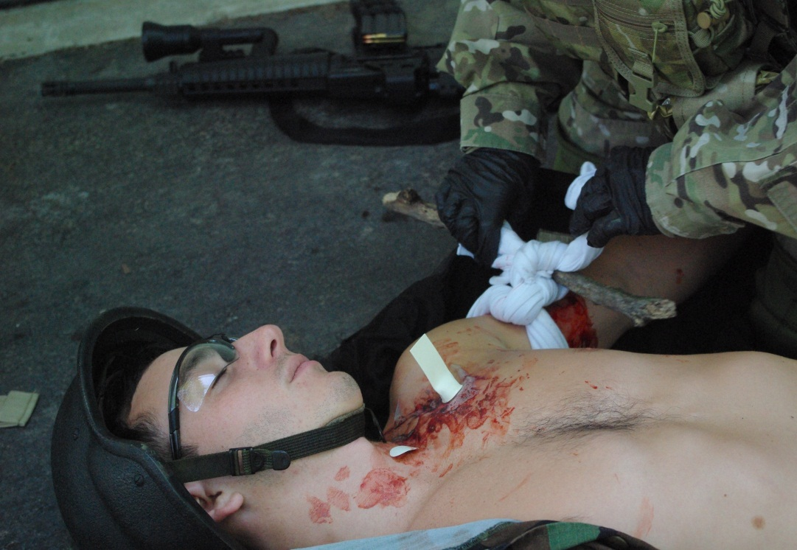
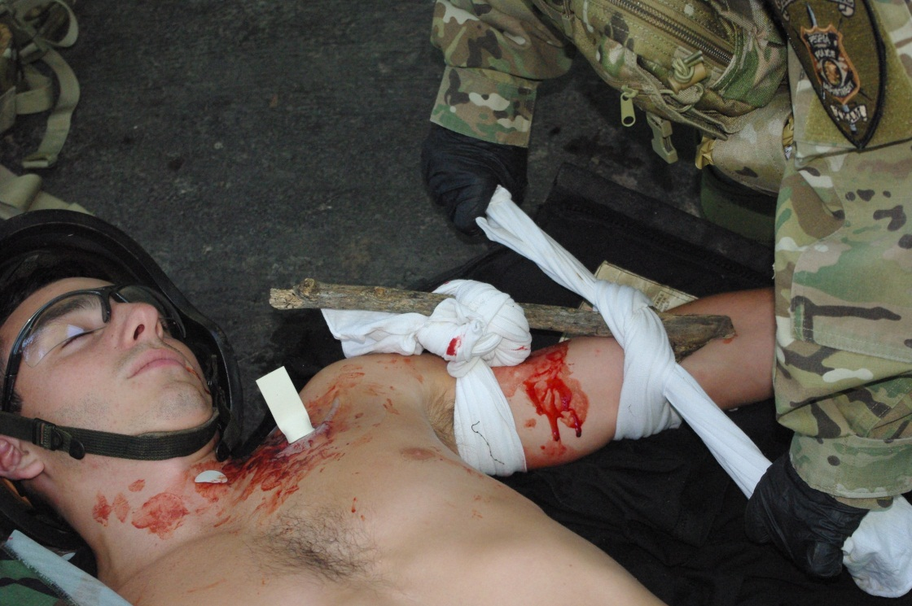
Triangular bandage as a TK

Slide 46
When No Commercial Tourniquet Is Available (cont)
Alternatively, a blood pressure cuff may be used
  Position it above (proximal) to bleeding point
  Inflate it just enough to stop bleeding
  Leave inflated until arrival at hospital
  Assign one person to monitor BP gauge continuously to make sure pressure is not gradually dropping
Hemorrhage – may be able to use a compression dressing for mild – moderate bleeds.

Slide 47
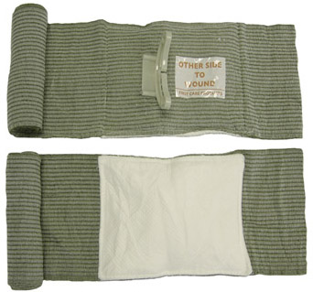
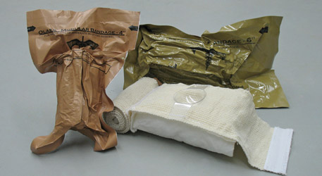
Hemorrhage Treatment
Two good compression dressings: The OLAES modular bandage (left) and Israeli battle dressing “Emergency Bandage” (right).
Courtesy of Tactical Medical Solutions, Inc.
Used with permission of PerSys Medical
(OLAES Bandage, named after Spec Ops medic Tony Olaes (pron ‘Ol-eye-as’ )

Slide 48
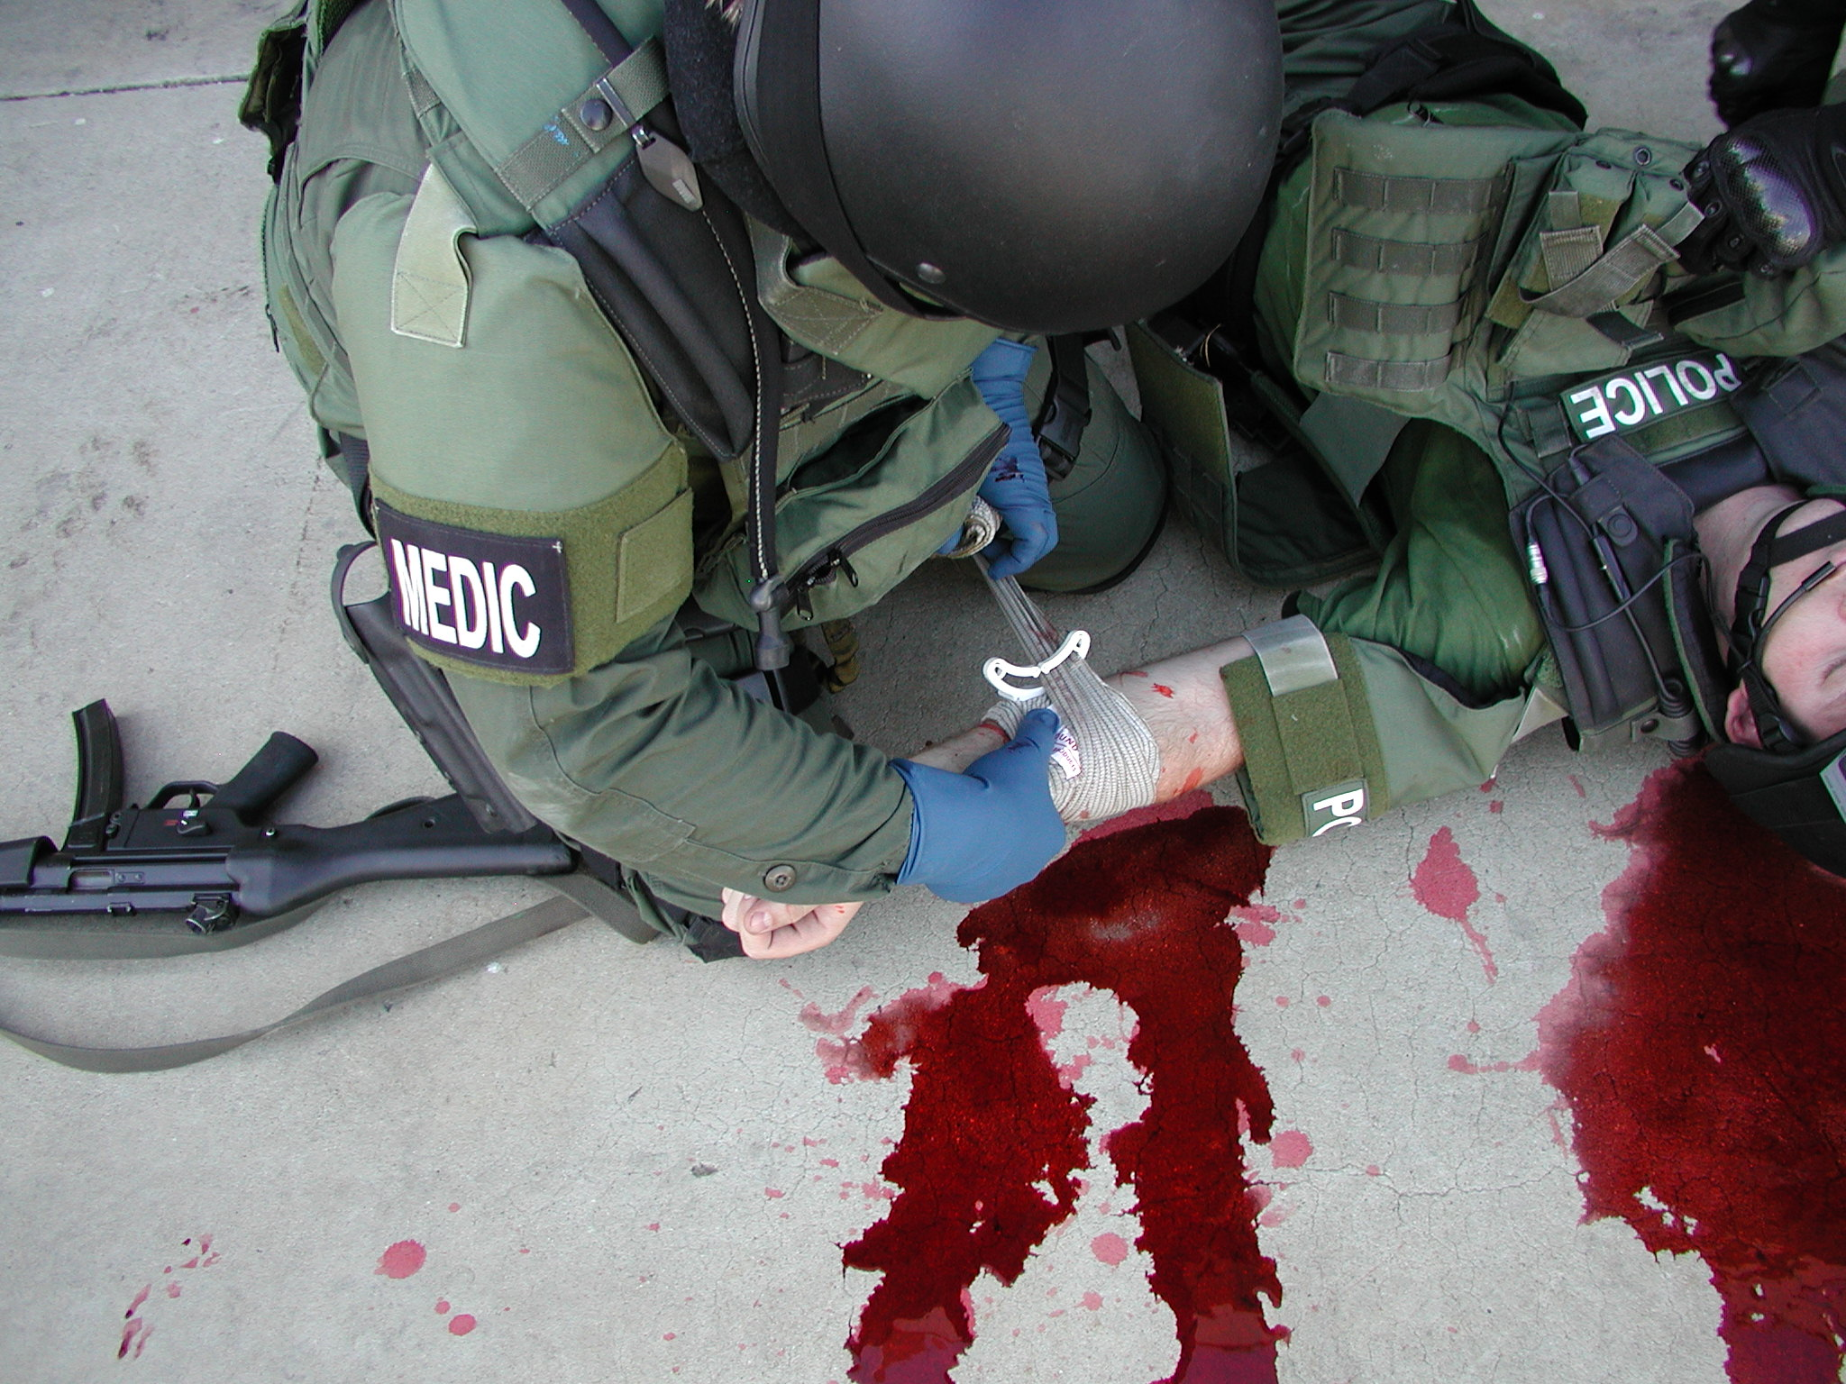

Slide 49
Summary
Three phases:
  1) High threat 2)Low threat 3) CASEVAC / transport
Call – A ➔ Communicate and Abolish threats.
Medical assessment / treatment ➔ continuum:
  CAB – N
    Circulation / current / compress killer bleeds
    Airway
    Breathing
  N = Neuro = neurological exam
Go = Go to the hospital!
Hot = keep patient warm, prevent hypothermia!

Slide 50
Summary
Tourniquets = first line when alone!
Compression bandages = use when buddy close.
Wound assessment and management:
  Search for possible injuries throughout casualty’s body
  Identify and apply stabilizing medical care
Torso Injuries = chest, abdomen, pelvis ➔ “load n’ go.”
Use PPE = do not become victim of an infectious disease…blood borne pathogens = preventable.

